Slide 1



CARBON CAPTURE
WEEK 2
Different Types of Carbon Capture Technology and processes.

Slide 2


Let's spell it out!
TOPIC OUTLINE
Day1- Post Combustion Capture Technology of Carbon Capture
Day2- Oxy Fuel Combustion Capture System
Day3- Pre Combustion Capture System
Day4 -New Future Technologies

Slide 3

DAY - 2
Pre-Combustion Capture System

Slide 4
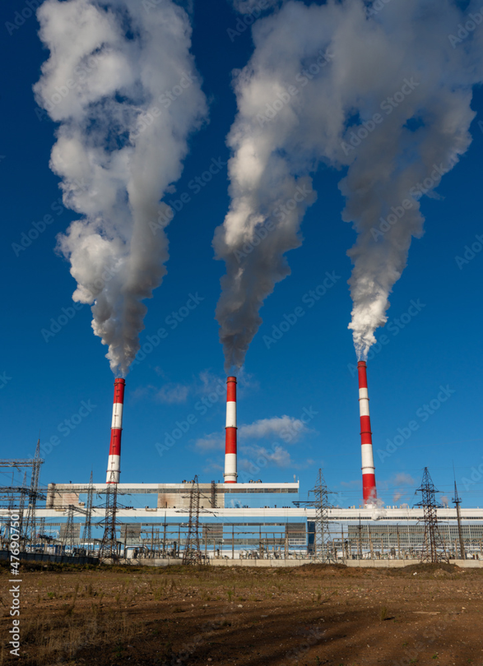

A pre-combustion capture process typically comprises a first stage of reaction producing a mixture of hydrogen and carbon monoxide (syngas) from a primary fuel. The two main routes are to add steam (reaction 1), in which case the process is called ‘steam reforming’, or oxygen (reaction 2) to the primary fuel. In the latter case, the process is often called ‘partial oxidation’ when applied to gaseous and liquid fuels and ‘gasification’ when applied to a solid fuel, but the principles are the same.
Steam reforming
Cx Hy + xH2 O ↔ xCO + (x+y/2)H2 ∆H +ve (1)
Partial oxidation
Cx Hy + x/2O2 ↔ xCO + (y/2)H2 ∆H –ve (2)

Slide 5


Additional hydrogen, together with CO2, is produced by reacting the carbon monoxide with steam in a second reactor (a “shift reactor”).
Water Gas Shift Reaction
CO + H2 O ↔ CO2 + H2 ∆H -41 kJ mol-1 (3)
The resulting mixture of hydrogen and CO2 can then be separated into a CO2 gas stream, and a stream of hydrogen. If the CO2 is stored, the hydrogen is a carbon-free energy carrier that can be combusted to generate power and/or heat. Although the initial fuel conversion steps are more elaborate and costly than in post-combustion systems, the high concentrations of CO2 produced by the shift reactor (typically 15 to 60% by volume on a dry basis) and the high pressures often encountered in these applications are more favourable for CO2 separation.

Slide 6
Pre-combustion would be used at power plants that employ integrated gasification combined cycle (IGCC) technology.
It is possible to envisage two applications of pre-combustion capture. The first is in producing a fuel (hydrogen) that is essentially carbon-free. Although the product H2 does not need to be absolutely pure and may contain low levels of methane, CO or CO2 , the lower the level of carbon-containing compounds, the greater the reduction in CO2 emissions. The H2 fuel may also contain inert diluents, such as nitrogen (when air is typically used for partial oxidation), depending on the production process and can be fired in a range of heaters, boilers, gas turbines or fuel cells.

Slide 7
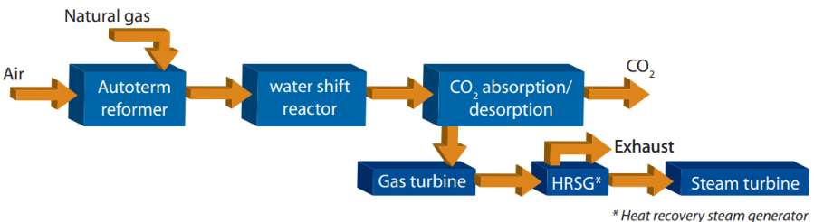
Secondly, pre-combustion capture can be used to reduce the carbon content of fuels, with the excess carbon (usually removed as CO2 ) being made available for storage. For example, when using a low H:C ratio fuel such as coal it is possible to gasify the coal and to convert the syngas to liquid Fischer-Tropsch fuels and chemicals which have a higher H:C ratio than coal.

Slide 8
This Figure shows a simple flowchart of the main processes in a hydrogen fuelled power plant with natural gas reformation. Fuel, water vapour and air are mixed in a reactor for chemical reforming of the fuel into carbon monoxide (CO) and hydrogen (H2 ). Reforming takes place at a high temperature and pressure and requires a supply of energy. The synthesis gas is then further converted to additional hydrogen in a so-called water shift reactor after being cooled to about 300°C. In this process CO reacts with water (H2 O) to form CO2 and H2 . CO2 is removed using amine absorption and hydrogen is used to fuel a gas turbine. Combustion of hydrogen emits no CO2 , only water vapour.

Slide 9
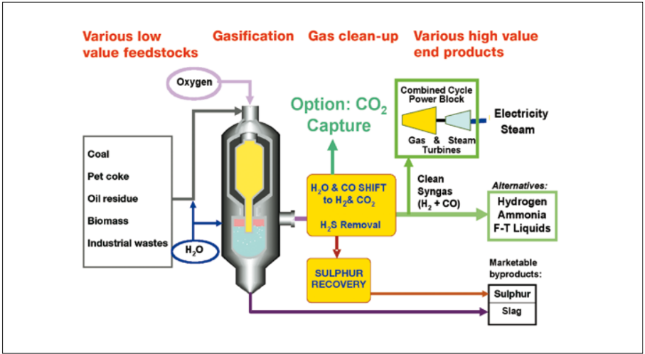
Gasification of coal, petroleum residues, or biomass

Slide 10
Gasification is a chemical process aimed at making high-value products (chemicals, electricity, clean synthetic fuels) out of low-value solid feedstocks such as coal, oil refining residues, or biomass. Gasification is basically partial oxidation (reaction 2), although steam is also supplied to the reactor in most processes. The gasifier output contains CO, H2 , CO2, H2 O and impurities (e.g., N2 , COS, H2 S, HCN, NH3 , volatile trace minerals and Hg) that must be managed appropriately. When CO2 capture is an objective, O2 -blown and high pressure systems are preferred because of the higher CO2 partial pressures. De-carbonization via gasification entails lower energy penalties for CO2 capture than does post-combustion capture when considering only the separation stage, because the CO2 can be recovered at partial pressures up to 3 orders of magnitude higher. This greatly reduces CO2 absorber size, solvent circulation rates and CO2 stripping energy requirements.

Slide 11
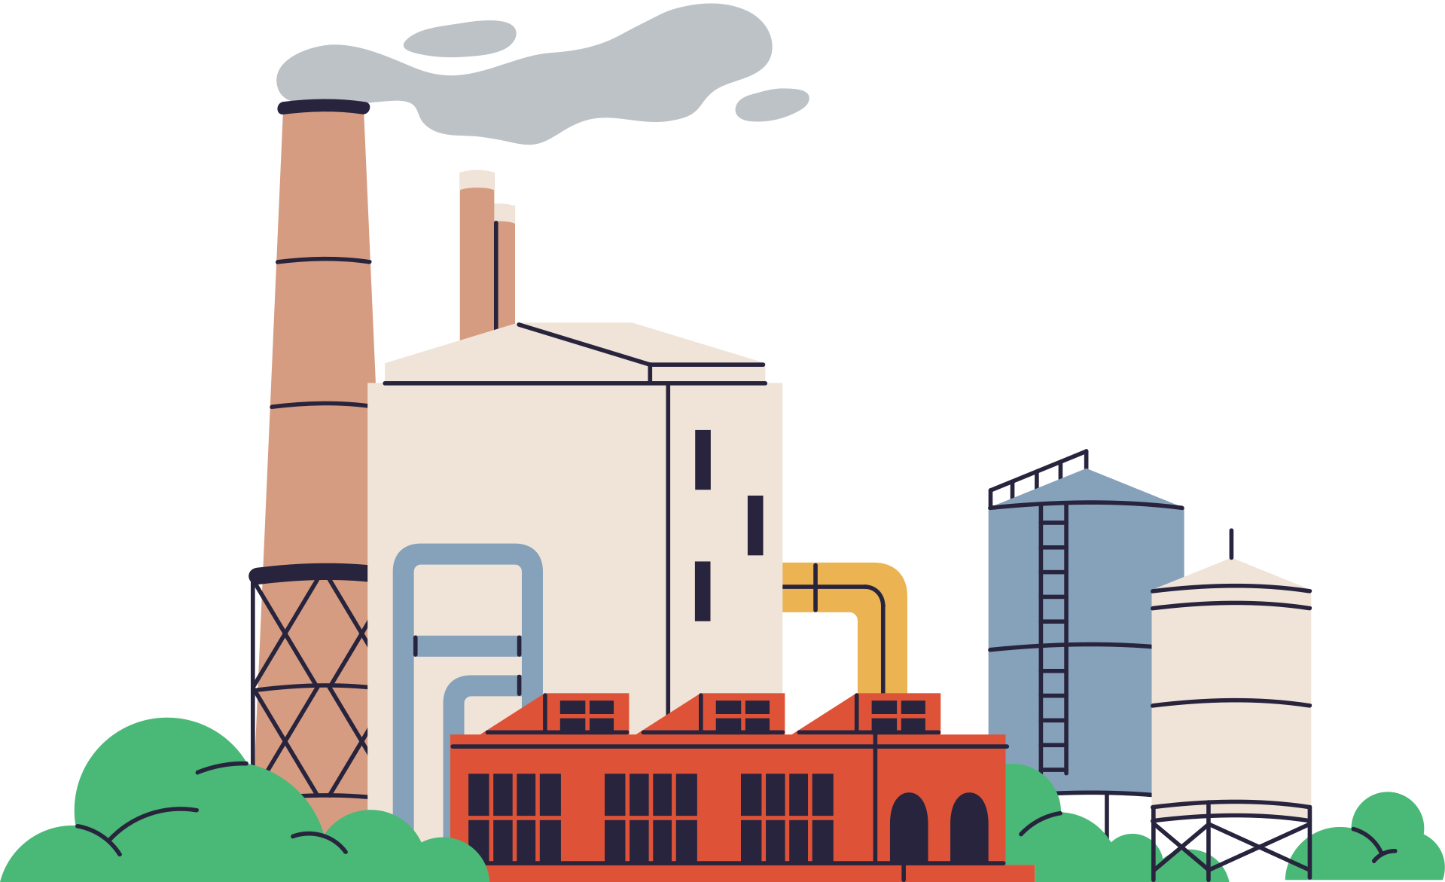
Integrated gasification combined cycle (IGCC) for power generation
In a coal IGCC, syngas exiting the gasifier is cleaned of particles, H2 S and other contaminants and then burned to make electricity via a gas turbine/steam turbine combined cycle. The syngas is generated and converted to electricity at the same site, both to avoid the high cost of pipeline transport of syngas and to cost-effectively exploit opportunities for making extra power in the combined cycle’s steam turbine using steam from syngas cooling. Because of the advantages for gasification of CO2 capture at high partial pressures discussed above, IGCC may be attractive for coal power plants in a carbon-constrained world. CO2 capture for pre-combustion systems is commercially ready, however, no IGCC plant incorporating CO2 capture has yet been built.Because of the advantages for gasification of CO2 capture at high partial pressures discussed above, IGCC may be attractive for coal power plants in a carbon-constrained world. CO2 capture for pre-combustion systems is commercially ready, however, no IGCC plant incorporating CO2 capture has yet been built.

Slide 12
Current Status
In principle, all pre-combustion systems are substantially similar in their conversion routes, allowing for differences that arise from the initial method employed for syngas production from gaseous, liquid or solid fuels and from the subsequent need to remove impurities that originate from the fuel feed to the plant. Once produced, the syngas is first cleaned and then reacted with steam to produce more H2 and CO2 .
The separation of these two gases can be achieved with well-known, commercial absorption-desorption methods, producing a CO2 stream suitable for storage. Also, intense R&D efforts worldwide are being directed towards the development of new systems that combine CO2 separation with some of the reaction steps, such as the steam reforming of natural gas or water gas shift reaction stages, but it is not yet clear if these emerging concepts will deliver a lower CO2 capture cost.

Slide 13
Current Status
Reforming of natural gas takes place at high temperatures and requires large amounts of energy. This reduces the electrical generation efficiency by 11 to 14 percentage points compared to conventional natural gas power plants. With the current technological level of gas turbines the generation efficiency of a plant of this type would be 44-47 percent.
To improve efficiency, research is exploring ways to reform the natural gas at lower temperatures and/ or using less steam. Another possibility is to have the CO2 separation and the feeding of hydrogen to the turbine happen at higher temperatures. To achieve this, the equilibrium for the reactions must be shifted by removing hydrogen or CO2 in the process.

Slide 14
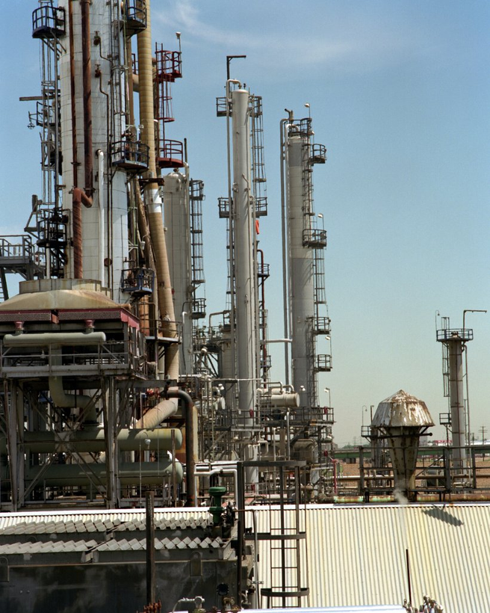
A gas power plant using natural gas reforming has yet to be built, but both natural gas reforming and gas turbines using high concentrations of hydrogen are technologies currently in use. This means the technology is considered to be mature and available and that such plants can be built as fast as conventional gas power plants. An advantage for this technology is its potential combination with the production of hydrogen for other purposes, such as hydrogen fuel. Compared to post-combustion separation less energy is required to pressurise CO2 for transport using this technology. The equipment is also smaller and can be built on a smaller site.

Slide 15
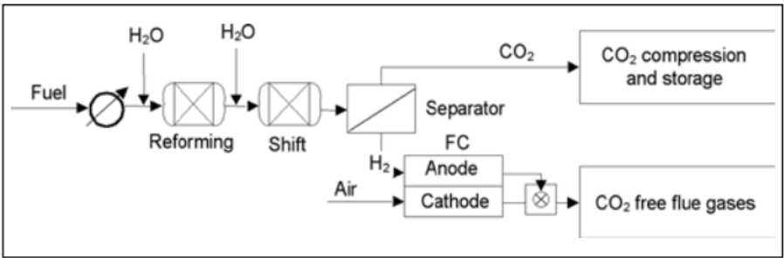

Figure 3.18a Fuel cell system with pre-fuel cell CO2 capture. The carbon-containing fuel is first completely converted into a mixture of hydrogen and CO2 . Hydrogen and CO2 are then separated and the H2 - rich fuel is oxidized in the fuel cell to produce electricity.
Technological development is needed to achieve hydrogen combustion with low NOx emissions combined with high efficiency. Hydrogen burns at a very high temperature. Current combustion chamber technology cannot burn pure hydrogen, which has to be mixed with nitrogen and/or water vapour to reduce temperature and NOx emissions. The NOx problem can be solved by developing better combustion technology or by removing NOx using a process such as selective catalytic reduction (SCR); this is already required in conventional gas power plants to meet NOx emission limits.

